Slide 1
Chapter 5
The Structure and Function of Large Biological Molecules

Slide 2
The Molecules of Life
All living things are made up of four classes of large biological molecules: carbohydrates, lipids, proteins, and nucleic acids
Macromolecules are large molecules composed of thousands of covalently connected atoms
Molecular structure and function are inseparable

Slide 3
Macromolecules are polymers, built from monomers
A polymer is a long molecule consisting of many similar building blocks
These small building-block molecules are called monomers
Three of the four classes of life’s organic molecules are polymers
Carbohydrates
Proteins
Nucleic acids

Slide 4
Synthesis and Breakdown of Polymers
A dehydration reaction occurs when two monomers bond together through the loss of a water molecule
Polymers are disassembled to monomers by hydrolysis, a reaction that is essentially the reverse of the dehydration reaction

Slide 5
Synthesis and Breakdown of Polymers
(a) Dehydration reaction: synthesizing a polymer
Short polymer
Unlinked monomer
Dehydration removes a water molecule, forming a new bond.
Longer polymer

Slide 6
Synthesis and Breakdown of Polymers
(b) Hydrolysis: breaking down a polymer
Hydrolysis adds a water molecule, breaking a bond.

Slide 7
Carbohydrates serve as fuel and building material
Carbohydrates include sugars and the polymers of sugars
The simplest carbohydrates are monosaccharides, or single sugars
Carbohydrate macromolecules are polysaccharides, polymers composed of many sugar building blocks

Slide 8
Sugars
Monosaccharides have molecular formulas that are usually multiples of CH₂O
Glucose (C₆H₁₂O₆) is the most common monosaccharide
Monosaccharides are classified by:
The location of the carbonyl group (as aldose or ketose)
The number of carbons in the carbon skeleton

Slide 9
Sugars
Aldose (Aldehyde Sugar)
Ketose (Ketone Sugar)
Trioses: 3-carbon sugars (C₃H₆O₃)
Glyceraldehyde
Dihydroxyacetone

Slide 10
Sugars
Aldose (Aldehyde Sugar)
Ketose (Ketone Sugar)
Pentoses: 5-carbon sugars (C₅H₁₀O₅)
Ribose
Ribulose

Slide 11
Sugars
Aldose (Aldehyde Sugar)
Ketose (Ketone Sugar)
Hexoses: 6-carbon sugars (C₆H₁₂O₆)
Glucose
Galactose
Fructose

Slide 12
Sugars
Though often drawn as linear skeletons, in aqueous solutions many sugars form rings
Monosaccharides serve as a major fuel for cells and as raw material for building molecules

Slide 13
Sugars
A disaccharide is formed when a dehydration reaction joins two monosaccharides
This covalent bond is called a glycosidic linkage

Slide 14
Sugars
Glucose
Glucose
Maltose
a) Dehydration reaction in the synthesis of maltose
Glucose
Fructose
Sucrose
b) Dehydration reaction in the synthesis of sucrose

Slide 15
Polysaccharides
Polysaccharides, have storage and structural roles
The structure and function of a polysaccharide are determined by its sugar monomers and the positions of glycosidic linkages

Slide 16
Storage Polysaccharides
Starch, a storage polysaccharide of plants, consists entirely of glucose monomers
Plants store surplus starch as granules within chloroplasts and other plastids
The simplest form of starch is amylose

Slide 17
Storage Polysaccharides
Glycogen is a storage polysaccharide in animals
Humans and other vertebrates store glycogen mainly in liver and muscle cells

Slide 18
Structural Polysaccharides
The polysaccharide cellulose is a major component of the tough wall of plant cells
Like starch, cellulose is a polymer of glucose, but the glycosidic linkages differ
The difference is based on two ring forms for glucose: alpha (α) and beta (β)

Slide 19
Structural Polysaccharides
a) α and β glucose ring structures
α Glucose
β Glucose
b) Starch: 1–4 linkage of α glucose monomers
c) Cellulose: 1–4 linkage of β glucose monomers

Slide 20
Structural Polysaccharides
Enzymes that digest starch by hydrolyzing α linkages can’t hydrolyze β linkages in cellulose
Cellulose in human food passes through the digestive tract as insoluble fiber
Some microbes use enzymes to digest cellulose
Many herbivores, from cows to termites, have symbiotic relationships with these microbes

Slide 21
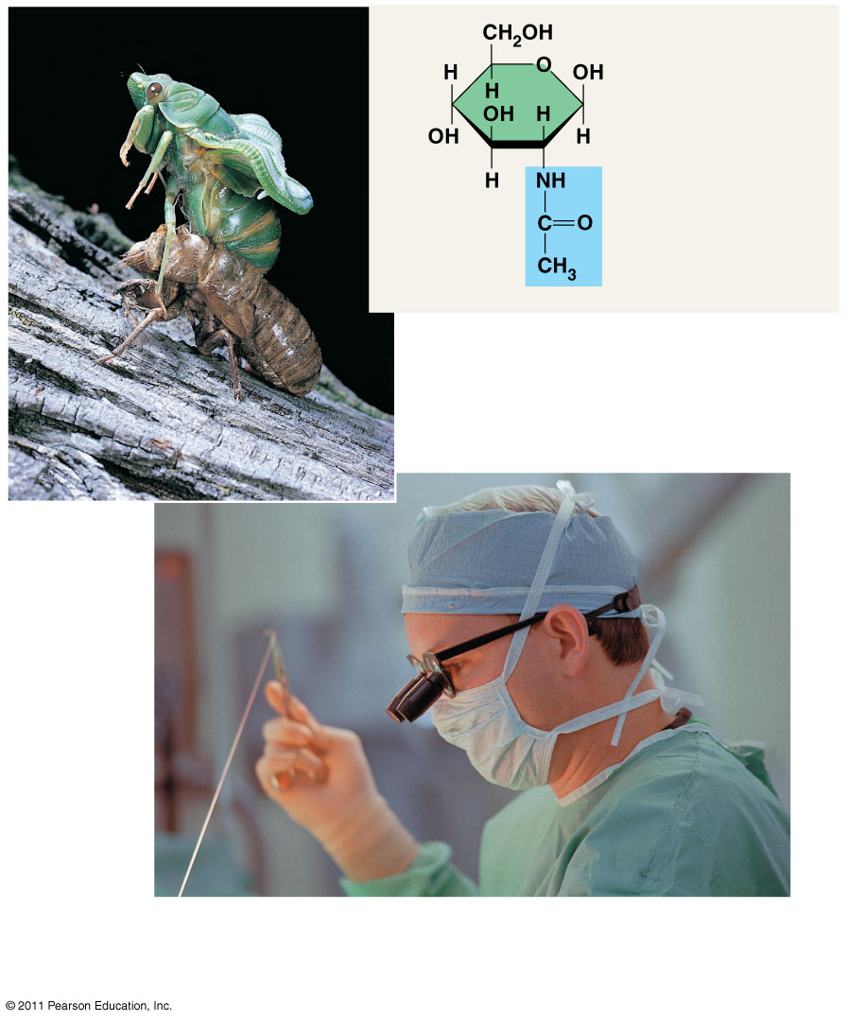
Structural Polysaccharides
Chitin, another structural polysaccharide, is found in the exoskeleton of arthropods
Chitin also provides structural support for the cell walls of many fungi
Chitin is used to make a strong and flexible surgical thread that decomposes after the wound or incision heals.
Chitin forms the exoskeleton of arthropods.

Slide 22
Lipids are a diverse group of hydrophobic molecules
Lipids are the one class of large biological molecules that do not form polymers
The unifying feature of lipids is having little or no affinity for water
Lipids are hydrophobic because they consist mostly of hydrocarbons, which form nonpolar covalent bonds
The most biologically important lipids are fats, phospholipids, and steroids

Slide 23
Fats
Fats are constructed from two types of smaller molecules: glycerol and fatty acids
Glycerol is a three-carbon alcohol with a hydroxyl group attached to each carbon
A fatty acid consists of a carboxyl group attached to a long carbon skeleton

Slide 24
Fats
Ester linkage
Fat molecule (triacylglycerol)

Slide 25
Fats
Fats separate from water because water molecules form hydrogen bonds with each other and exclude the fats
In a fat, three fatty acids are joined to glycerol by an ester linkage, creating a triacylglycerol, or triglyceride

Slide 26
Fats
Fatty acids vary in length (number of carbons) and in the number and locations of double bonds
Saturated fatty acids have the maximum number of hydrogen atoms possible and no double bonds
Unsaturated fatty acids have one or more double bonds

Slide 27
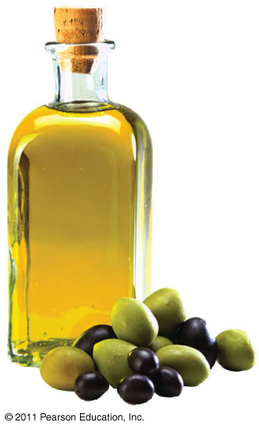
Fats
Saturated fat
Unsaturated fat

Slide 28
Fats
Fats made from saturated fatty acids are called saturated fats, and are solid at room temperature
Most animal fats are saturated
Fats made from unsaturated fatty acids are called unsaturated fats or oils, and are liquid at room temperature
Plant fats and fish fats are usually unsaturated

Slide 29
Fats
A diet rich in saturated fats may contribute to cardiovascular disease through plaque deposits
Hydrogenation is the process of converting unsaturated fats to saturated fats by adding hydrogen
Hydrogenating vegetable oils also creates unsaturated fats with trans double bonds
These trans fats may contribute more than saturated fats to cardiovascular disease

Slide 30
Fats
Certain unsaturated fatty acids are not synthesized in the human body
These must be supplied in the diet
These essential fatty acids include the omega-3 fatty acids, required for normal growth, and thought to provide protection against cardiovascular disease

Slide 31
Fats
The major function of fats is energy storage
Humans and other mammals store their fat in adipose cells
Adipose tissue also cushions vital organs and insulates the body

Slide 32
Phospholipids
In a phospholipid, two fatty acids and a phosphate group are attached to glycerol
The two fatty acid tails are hydrophobic, but the phosphate group and its attachments form a hydrophilic head

Slide 33
Phospholipids
Hydrophilic head
Hydrophilic head
Hydrophobic tails
Hydrophobic tails

Slide 34
Phospholipids
When phospholipids are added to water, they self-assemble into a bilayer, with the hydrophobic tails pointing toward the interior
The structure of phospholipids results in a bilayer arrangement found in cell membranes
Phospholipids are the major component of all cell membranes

Slide 35
Phospholipids
Hydrophilic head
Hydrophobic tail
WATER

Slide 36
Steroids
Steroids are lipids characterized by a carbon skeleton consisting of four fused rings
Cholesterol, an important steroid, is a component in animal cell membranes
Although cholesterol is essential in animals, high levels in the blood may contribute to cardiovascular disease

Slide 37
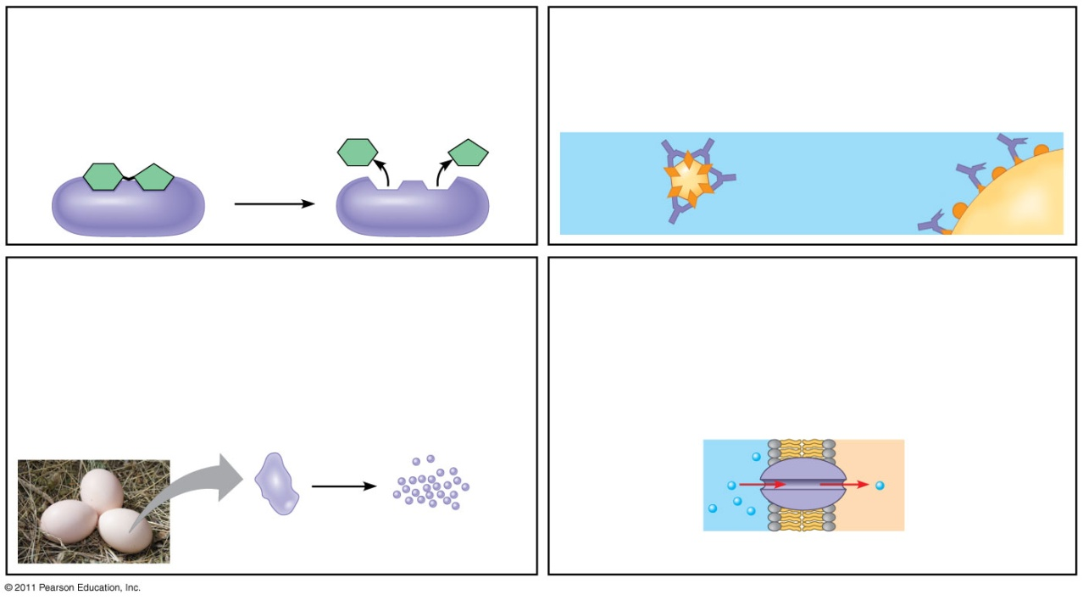
Proteins include a diversity of structures, resulting in a wide range of functions
Protein functions include structural support, storage, transport, cellular communications, movement, and defense against foreign substances
Enzymatic proteins
Defensive proteins
Storage proteins
Transport proteins

Slide 38
Proteins include a diversity of structures, resulting in a wide range of functions
Enzymatic proteins
Function: Selective acceleration of chemical reactions
Example: Digestive enzymes catalyze the hydrolysis of bonds in food molecules.

Slide 39
Proteins include a diversity of structures, resulting in a wide range of functions
Defensive proteins
Function: Protection against disease
Example: Antibodies inactivate and help destroy viruses and bacteria.

Slide 40
Proteins include a diversity of structures, resulting in a wide range of functions
Transport proteins
Function: Transport of substances
Examples: Hemoglobin, the iron-containing protein of vertebrate blood, transports oxygen from the lungs to other parts of the body. Other proteins transport molecules across cell membranes.
Transport protein
Cell membrane

Slide 41
Proteins
Enzymes are a type of protein that acts as a catalyst to speed up chemical reactions
Enzymes can perform their functions repeatedly, functioning as workhorses that carry out the processes of life

Slide 42
Polypeptides
Polypeptides are unbranched polymers built from the same set of 20 amino acids
A protein is a biologically functional molecule that consists of one or more polypeptides

Slide 43
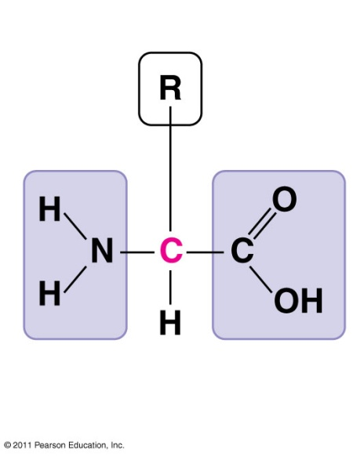
Amino Acid Monomers
Amino acids are organic molecules with carboxyl and amino groups
Amino acids differ in their properties due to differing side chains, called R groups
Side chain (R group)
Amino group
Carboxyl group

Slide 44
Proteins
Amino acids are linked by peptide bonds
A polypeptide is a polymer of amino acids
Polypeptides range in length from a few to more than a thousand monomers
A functional protein consists of one or more polypeptides precisely twisted, folded, and coiled into a unique shape

Slide 45
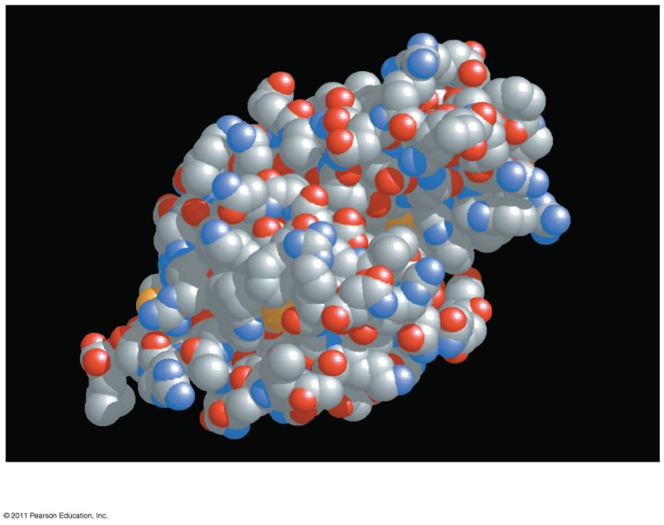
Proteins
The sequence of amino acids determines a protein’s three-dimensional structure
A protein’s structure determines its function

Slide 46
Four Levels of Protein Structure
The primary structure of a protein is its unique sequence of amino acids
Secondary structure, found in most proteins, consists of coils and folds in the polypeptide chain
Tertiary structure is determined by interactions among various side chains (R groups)
Quaternary structure results when a protein consists of multiple polypeptide chains

Slide 47
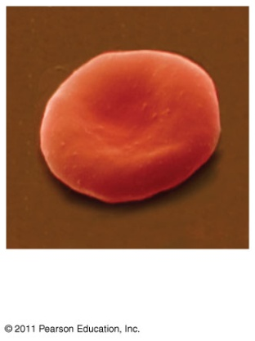
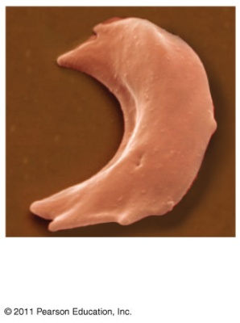
Sickle-Cell Disease: A Change in Primary Structure
A slight change in primary structure can affect a protein’s structure and ability to function
Sickle-cell disease, an inherited blood disorder, results from a single amino acid substitution in the protein hemoglobin

Slide 48
What Determines Protein Structure?
In addition to primary structure, physical and chemical conditions can affect structure
Alterations in pH, salt concentration, temperature, or other environmental factors can cause a protein to unravel
This loss of a protein’s native structure is called denaturation
A denatured protein is biologically inactive

Slide 49
Nucleic acids store, transmit, and help express hereditary information
The amino acid sequence of a polypeptide is programmed by a unit of inheritance called a gene
Genes are made of DNA, a nucleic acid made of monomers called nucleotides

Slide 50
The Roles of Nucleic Acids
There are two types of nucleic acids
Deoxyribonucleic acid (DNA)
Ribonucleic acid (RNA)
DNA provides directions for its own replication
DNA directs synthesis of messenger RNA (mRNA) and, through mRNA, controls protein synthesis
Protein synthesis occurs on ribosomes

Slide 51
DNA
Synthesis of mRNA
Movement of mRNA into cytoplasm
Synthesis of protein

Slide 52
The Components of Nucleic Acids
Nucleic acids are polymers called polynucleotides
Each polynucleotide is made of monomers called nucleotides
Each nucleotide consists of a nitrogenous base, a pentose sugar, and one or more phosphate groups
The portion of a nucleotide without the phosphate group is called a nucleoside

Slide 53
Nucleic Acid
Sugar-phosphate backbone
Thymine (T, in DNA
Cytosine (C)
Uracil (U, in RNA
Adenine (A)
Guanine (G
Polynucleotide, or nucleic acid

Slide 54
Nucleic Acid
Nucleoside = nitrogenous base + sugar
There are two families of nitrogenous bases
Pyrimidines (cytosine, thymine, and uracil) have a single six-membered ring
Purines (adenine and guanine) have a six-membered ring fused to a five-membered ring
In DNA, the sugar is deoxyribose; in RNA, the sugar is ribose
Nucleotide = nucleoside + phosphate group

Slide 55
Nucleic Acid
Nucleotide polymers are linked together to build a polynucleotide
Adjacent nucleotides are joined by covalent bonds that form between the —OH group on the 3′ carbon of one nucleotide and the phosphate on the 5′ carbon on the next
These links create a backbone of sugar-phosphate units with nitrogenous bases as appendages
The sequence of bases along a DNA or mRNA polymer is unique for each gene

Slide 56
Structures of DNA and RNA Molecules
RNA molecules usually exist as single polypeptide chains
DNA molecules have two polynucleotides spiraling around an imaginary axis, forming a double helix
In the DNA double helix, the two backbones run in opposite 5′→ 3′ directions from each other, an arrangement referred to as antiparallel
One DNA molecule includes many genes

Slide 57
Structures of DNA and RNA Molecules
The nitrogenous bases in DNA pair up and form hydrogen bonds: adenine (A) always with thymine (T), and guanine (G) always with cytosine (C)
Called complementary base pairing
Complementary pairing can also occur between two RNA molecules or between parts of the same molecule
In RNA, thymine is replaced by uracil (U) so A and U pair

Slide 58
Structures of DNA and RNA Molecules
3′
5′
Sugar-phosphate backbones
DNA
Base pair joined by hydrogen bonding
Base pair joined by hydrogen bonding
3′
5′
Transfer RNA

Slide 59
DNA: Tape Measures of Evolution
The linear sequences of nucleotides in DNA molecules are passed from parents to offspring
Two closely related species are more similar in DNA than are more distantly related species
Molecular biology can be used to assess evolutionary kinship

Slide 60
The End

